Slide 1

AI Gateway
Daniel Benner Partner Technical Specialist
dbenner@us.ibm.com
512.825.6186

Slide 2

Presentation on AI Gateway by
Daniel Benner Partner Technical Specialist
dbenner@us.ibm.com
512.825.6186
With the ADK, you can onboard custom LLM models from external providers and create model policies to manage multi-model workflows in your agents. This is referred to as the AI gateway.
wxO Advanced Workshop Sept 9-10

Slide 3
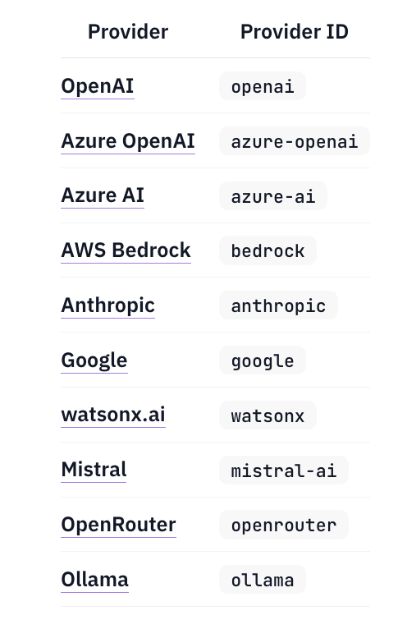
Managing custom LLMs with the AI gateway Supported providers
wxO Advanced Workshop Sept 9-10

Slide 4
Create an API key connection
wxO Advanced Workshop Sept 9-10

Slide 5
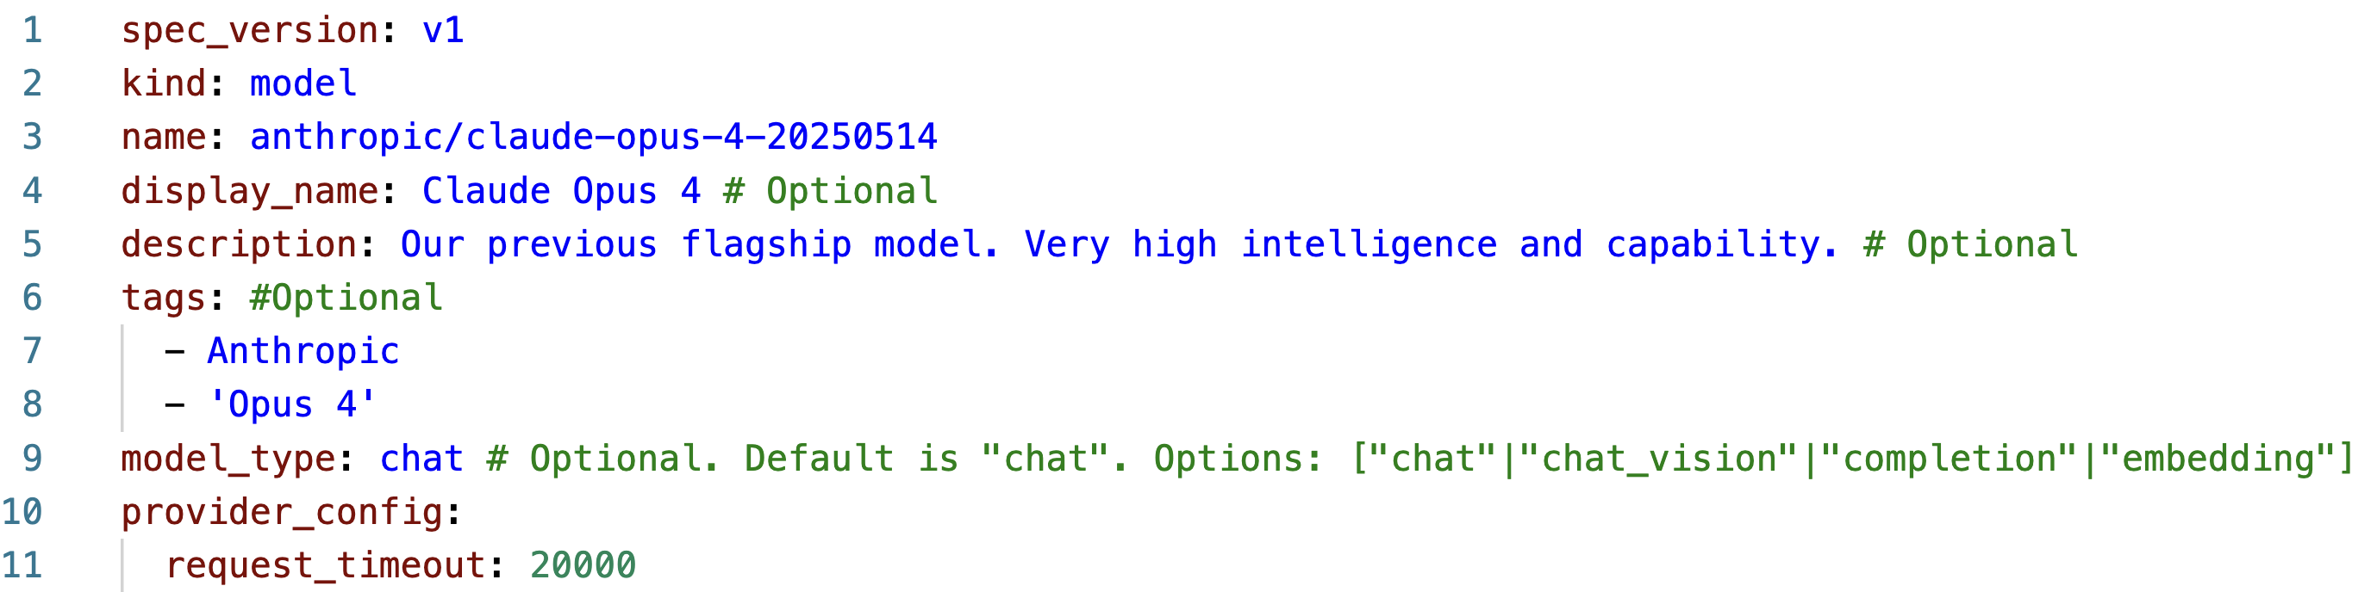
Define the model specifications
wxO Advanced Workshop Sept 9-10

Slide 6
Add the model
wxO Advanced Workshop Sept 9-10

Slide 7
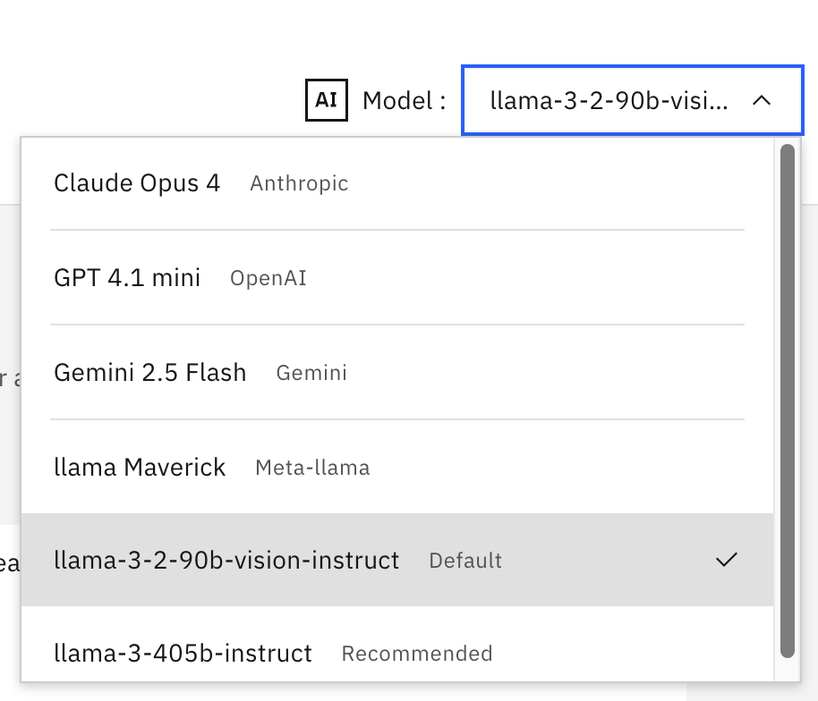
Model display name and tags
wxO Advanced Workshop Sept 9-10

Slide 8
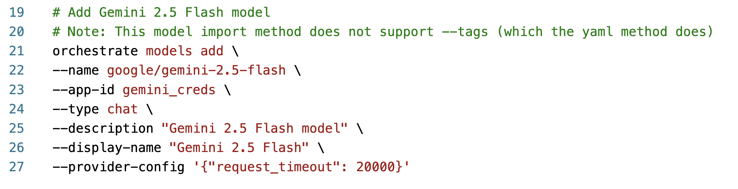
Add models via the CLI
wxO Advanced Workshop Sept 9-10

Slide 9
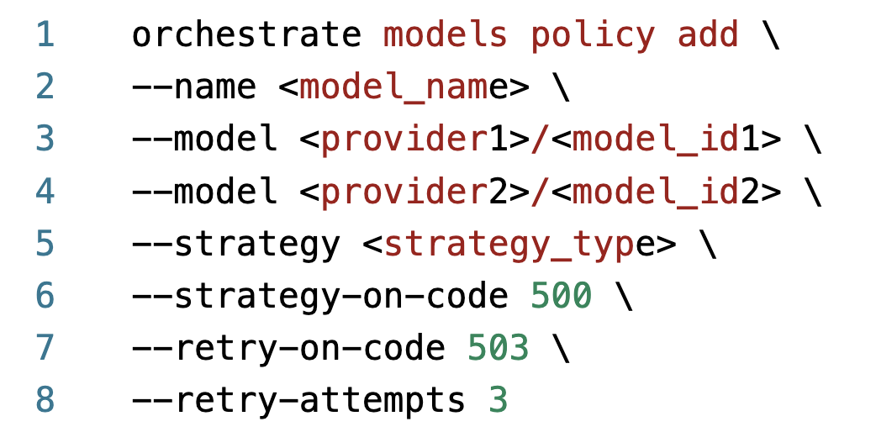
Add models policies via CLI
wxO Advanced Workshop Sept 9-10

Slide 10
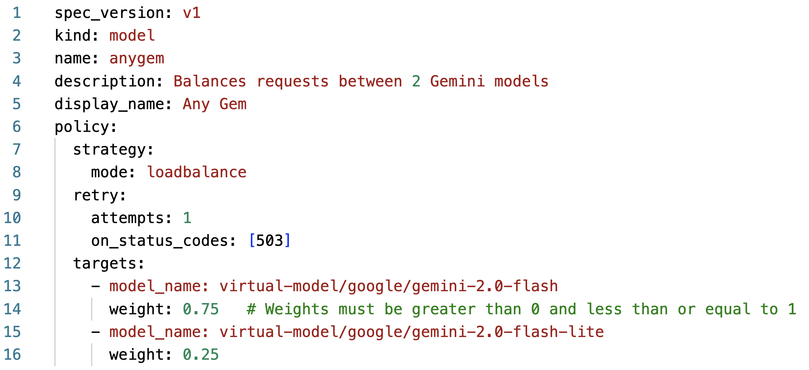
Import models policies
wxO Advanced Workshop Sept 9-10

Slide 11
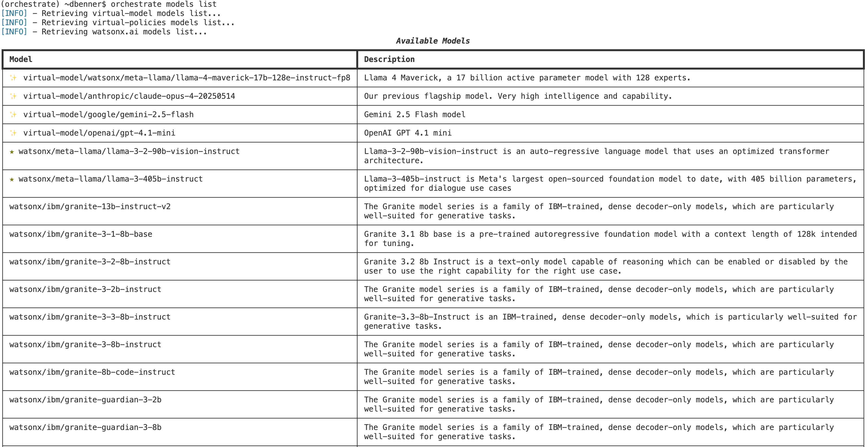
Models list command
orchestrate models list –r
wxO Advanced Workshop Sept 9-10

Slide 12
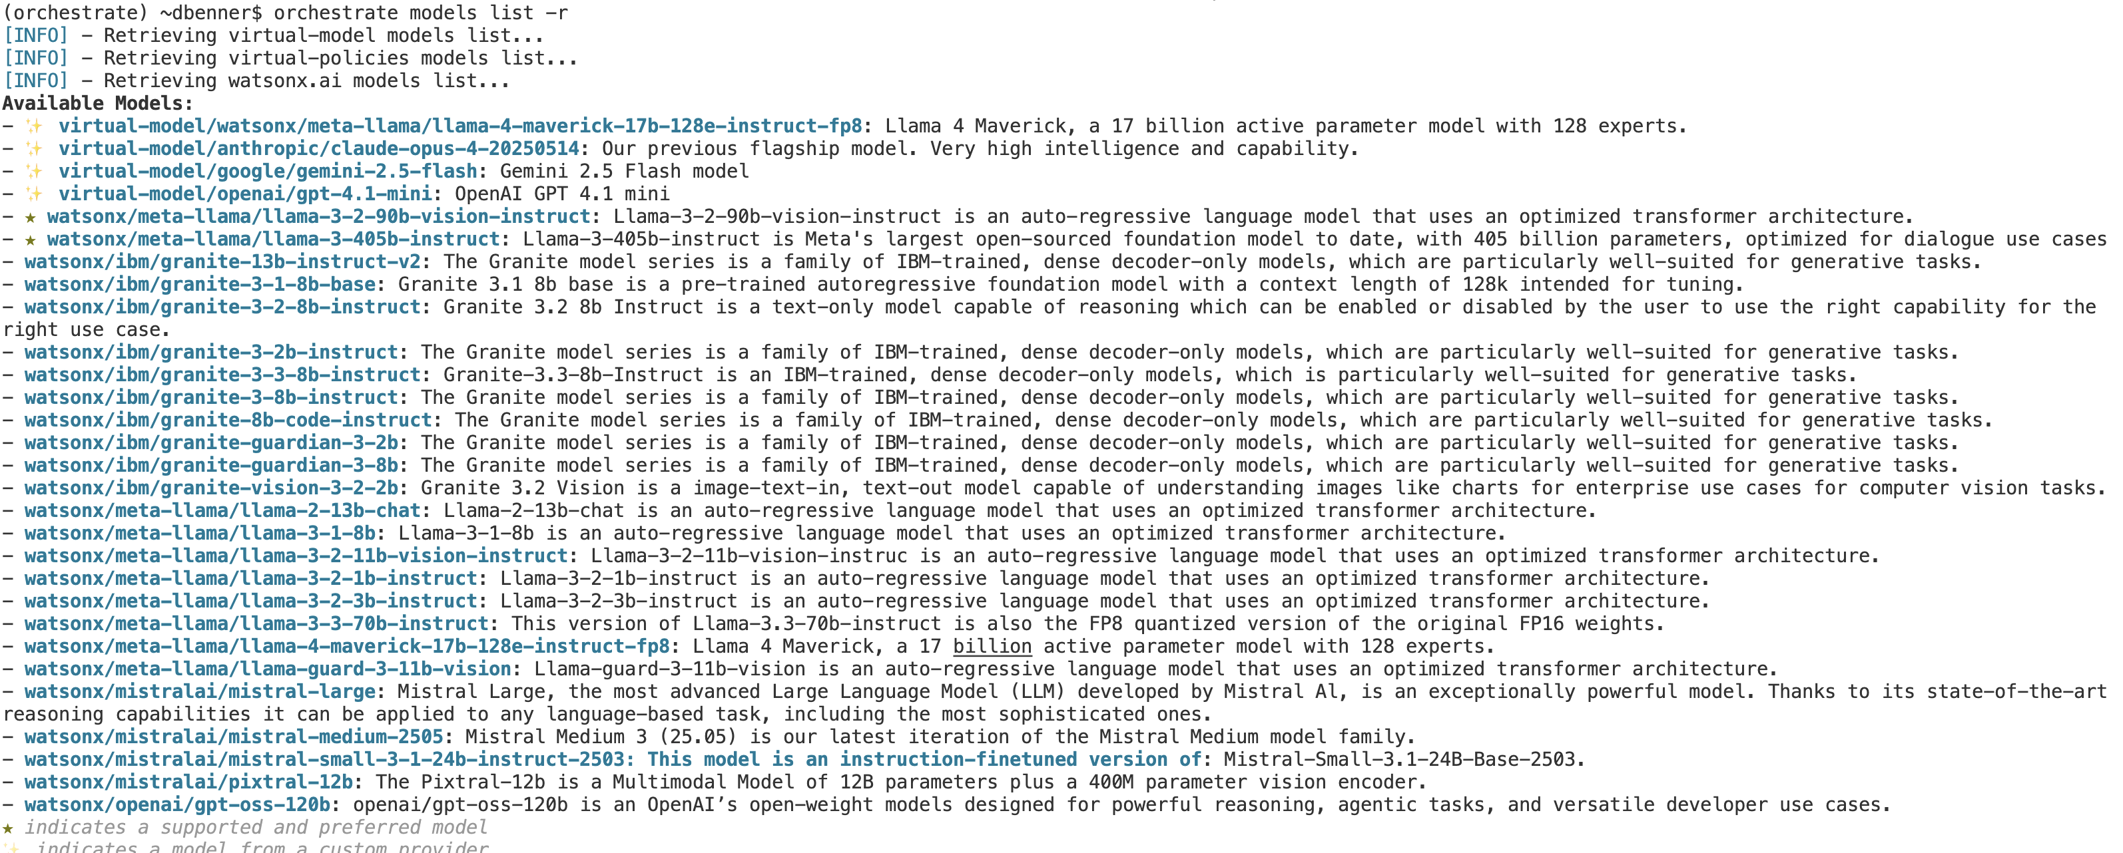
Models list command
orchestrate models list -r
wxO Advanced Workshop Sept 9-10

Slide 13
Models list command
orchestrate models list -r
wxO Advanced Workshop Sept 9-10
Notes:
r stands for raw format

Slide 14
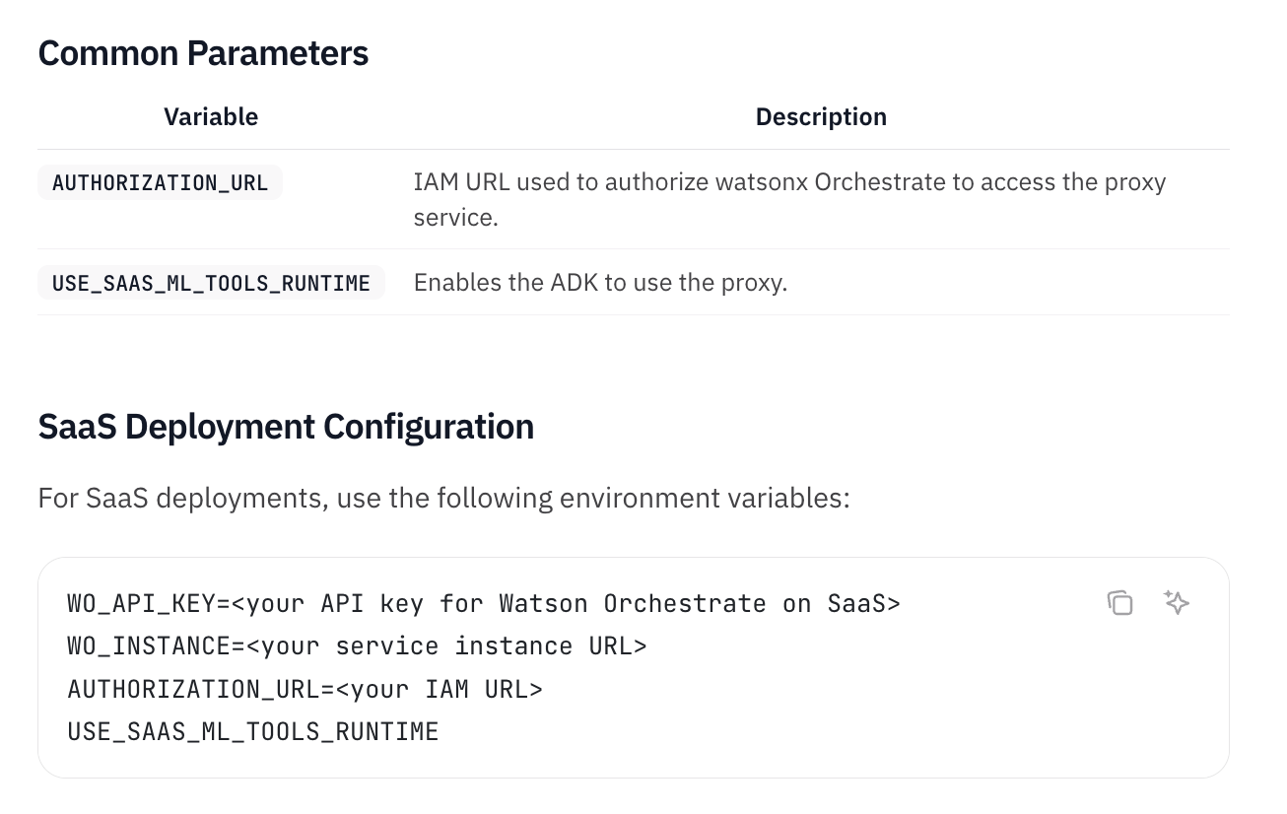
Enabling watsonx/* models
wxO Advanced Workshop Sept 9-10

